Slide 1
Presentation by
idsa
Ajey Lele
IDSA, New Delhi
at
IIC
on
March 02, 2016

Slide 2
India & Challenges from Space Weaponisation

Slide 3
India in Space……
A reasonable success story. Could be considered as Category II player
Very successful remote-sensing programme, have several commutation and few scientific satellites, in the final stages of establishing a regional navigational network. Also, have made investments to undertake activities in the Deep space
In terms of capabilities the basic limitation comes from the absence of heavy satellite launcher
There are more than 30 operational satellites in space at present

Slide 4
Weaponisation for What?
Security
Deterrence
Space Race
One-upmanship
Drawing lessons from NPT Regime
Drawing lessons from Antarctica Treaty

Slide 5
India and Space Weaponisation
India is against the weaponisation of outer space
Space debris mitigation guidelines, Inter-Agency Space Debris Coordination Committee (IADC)-ISRO is a member
One odd statement could be found in regards to India’s technical capability to undertake ASAT. However, this is not about the intent but more about the ability
Debris-less ASAT…open to debate

Slide 6
Is Weaponisation a Reality?
There are strong indications
Need is to ‘read between the lines’
Can weaponisation be avoided?
Are there any benefits of weaponisation!!!!

Slide 7
Cold War Era: Rationalization for ASAT…
Soviet space capabilities had changed from general intelligence collection to direct support of military forces, and their new capabilities, particularly to use satellites to target the US warships at sea was the justification for the development of an ASAT
Is similar justification (!) applicable today??? Or could be offered by some state (s)???

Slide 8
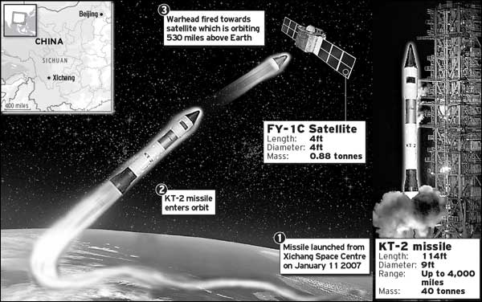
Space War
“Space War” is being discussed since the “Sputnik Era”
However, after the end of Cold War till the Jan 2007 ASAT by China this issue was generally overlooked by many

Slide 9
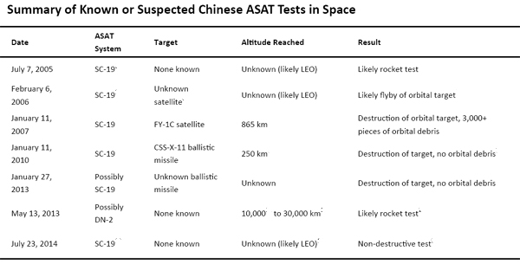
SW Foundation

Slide 10
Russian ASAT
Russia carried out the first successful flight test of a new anti-satellite missile, marking a new phase in the global militarization of space
The flight test of Russia’s direct ascent anti-satellite missile, known as Nudol, took place Nov 18, 2015
It was the first successful test in three attempts

Slide 11
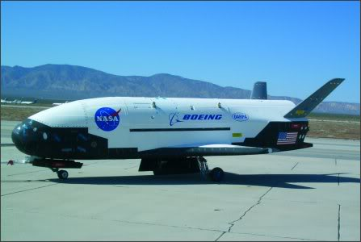
US Spy Plane X-37B Orbital Test Vehicle (OTV)
Launched on an Atlas rocket and put into a low orbit, a little over 300km up
Space-to-space surveillance (stay at an orbit between 200 and 800 km)
First vehicle launched on 22 Apr, 2010, and landed eight months later
Second mission 05 Mar 2011-16 Jun 2012
Third mission 11 Dec 2012-17 Oct 2014
Fourth mission 20 May 2015-----
Spying on Tiangone???
Proving technologies necessary for long duration reusable space vehicles with autonomous reentry and landing capabilities

Slide 12
A Perspective
Major states in the world are testing their ASAT capabilities overtly/covertly, directly/indirectly, partially/fully….does this mean that India should get carried away?
There could be efforts to ‘market’ space-to-ground offensive capability to the political leadership
Indian satellites could be targeted in case of any ‘eventualities’ (KKV). The probability of a debris hit to any Indian satellite increases even when a third country attacks the satellite of the fourth country

Slide 13
Is Hard-kill the Only ASAT Option?
Orbital weapons: space-mines, lasers, ….
Ground-based Lasers
Jamming
Cyber

Slide 14
Soviet Co-Orbital ASAT System
Co-orbital strategy: a weapon armed with conventional explosives is launched into the same orbit as the target satellite and moves near enough to destroy it
1978 to 1982:Tested about one intercept a year (the system was decommissioned in 1993)
Could such system be made operational again???
Air-Launched Miniature Vehicle (ALMV)…The US system (1982)

Slide 15
Take account of…
Technologies and policies for debris removal
On-Orbit Satellite Servicing
Weapons in space
SSA efforts
Space tourism

Slide 16
The Truth…
The “Pearl Harbour” syndrome
Missile defence policies
Legal regime unlikely in near future. Space disarmament and arms control debate in nascent stage
Line between militarization and weaponisation getting thin….

Slide 17
Concept of Deterrence
Nuclear deterrence…..What is important is dissuasion…create a fear….. ‘nuclear’ is just ‘a means’
Bows, arrows and nuclear weapons
Could Orbital Weapons emerge as an alternative deterrence

Slide 18
Likely possibilities…
Many states could probably peruse double policy: engage in anti-satellite arms control talks
Debate the dangers of weaponisation of space
Without much of fanfare continue pursuing (may test too) anti-satellite technology…KKV to jamming to cyber

Slide 19
The Challenge
Can India foolishly turn a blind eye to such ASAT related developments?
There is a need to acknowledge the “gravity” of situation
Need to develop counter-capabilities to ensure security of its space assets
The real challenge is to ensure that under no circumstances a capability gets designed which could end up creating space debris

Slide 20
Decide on…
Look for diplomatic alternatives, device means to control offensive armaments
Develop technologies for strengthening of the protection of orbiting systems
Intergovernmental collaboration
Avoid massive investment in fully autonomous resources

Slide 21
In Summation…
Weaponisation of space….likely to happen
The potential targets could be satellites in LEO. However, technologies/techniques are in making which could target MEO/GEO birds
Diplomacy is the best option. However, how much effective it would be?
There is a need to develop capabilities in jamming and cyber arena. Debris less ASAT option needs to be debated
Strategic Space Warfare Weapons….could this be the future?
Both Newton and Einstein are correct…… (in regards to) impact of ASAT

Slide 22
Thank You

Slide 23
Many people are familiar with the story of "Newton's Apple" - while sitting under a tree one day, Newton observed an apple falling in the distance and realized the moon he saw in the sky orbits the Earth because of the same force that made the apple fall. This force is gravity, and Newton recognized that gravity acts over distances without physical contact - after all, nothing was touching that famous apple to make it fall. Masses feel gravitational force because every mass in the universe has its own gravitational field, which adds together with all of the other fields in the universe. According to Newton's theory of gravity, when a mass changes position, the entire gravitational field throughout the universe changes instantaneously, and the resultant gravitational forces are instantly changed accordingly.
But Einstein's Theory of General Relativity - the most commonly accepted description of gravity - asserts that no information can travel faster than the speed of light, including information on the positions of mass in the universe, which is communicated through the gravitational field. General Relativity predicts that a change in gravitational field will travel through the universe at the speed of light. It is exactly these changes in gravitational field that are gravitational waves.

